Slide 1
Capstone Project The Battle of Neighborhoods

Slide 2

Business problem
Problem statement : To help an entrepreneur to find an ideal location for opening a new restaurant in New York.

Slide 3

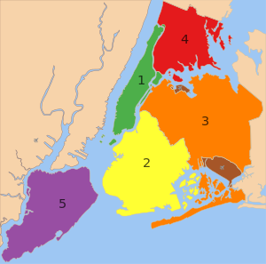
Introduction
The city I will be anlalyzing for finding the suitable location will be New York
The City of New York, usually called either New York City (NYC) or simply New York (NY), is the most populous city in the United States. With an estimated 2018 population of 8,398,748 distributed over a land area of about 302.6 square miles (784 km2), New York is also the most densely populated major city in the United States.

Slide 4
City economic overview
New York City is a global hub of business and commerce, as a center for banking and finance, retailing, world trade, transportation, tourism, real estate, new media, traditional media, advertising, legal services, accountancy, insurance, theater, fashion, and the arts in the United States; while Silicon Alley, metonymous for New York's broad-spectrum high technology sphere, continues to expand.

Slide 5
Data description
The data includes :
A dataset to segment the neighborhoods and explore them ,the data set consist of 5 boroughs and 30 neighborhoods. https://geo.nyu.edu/catalog/nyu_2451_34572
The Foursquare API will be used to explore neighborhoods in New York City
New York city geographical coordinates data will be utilized as input for the Foursquare API
List of all the cities in United States with population density and coordinates: https://en.wikipedia.org/wiki/List_of_United_States_cities_by_population
The data about population, population density and percapita income of different borough is analyzed. https://en.wikipedia.org/wiki/Boroughs_of_New_York_City

Slide 6
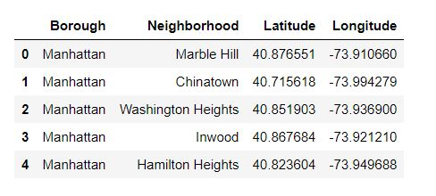
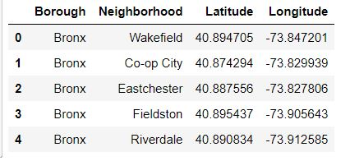
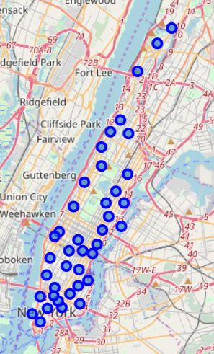
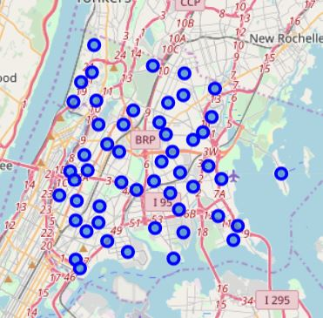
Data about five borough

Slide 7
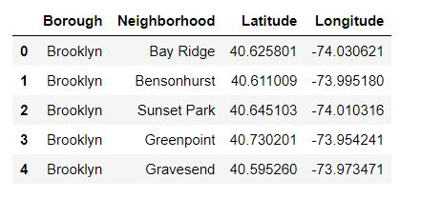
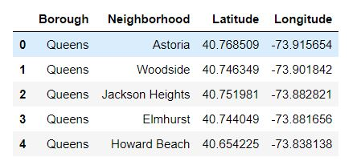
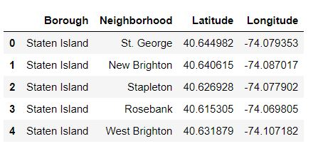
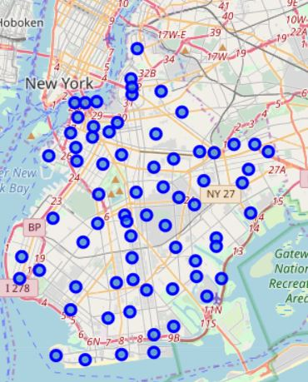
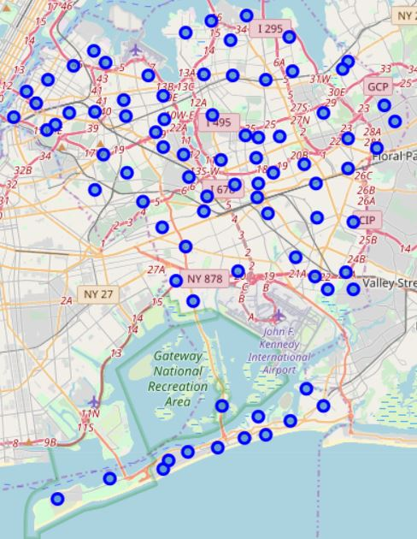
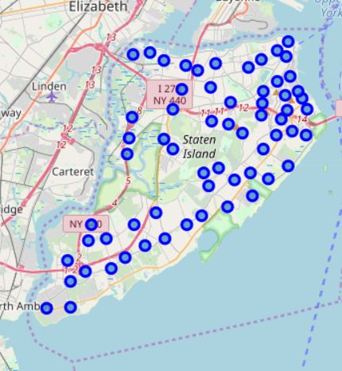

Slide 8
Methodology
In this project I will be analyzing the neighbourhood of New York based on certain factors to find a location that would be suitable for opening a new restaurant. The different factors I will be considering are:
Location of other restaurants in the area.
Nearby colleges and school ( so that they can start a section that could attract them)
vicinity
Distance from Airports
Historically significant area in the neighbourhood that can attract tourist
Menu of the competitors
Availability of food materials ( Any markets nearby)

Slide 9
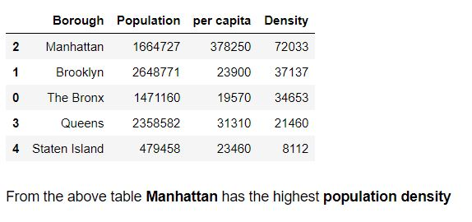
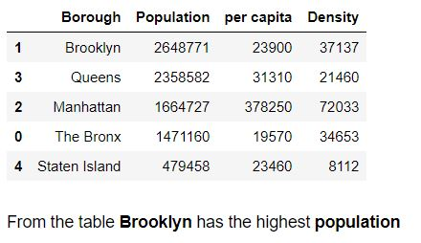
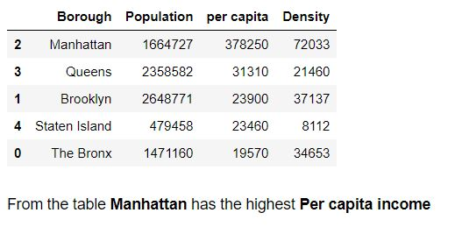
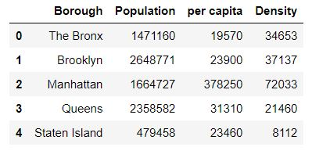
1. Choosing the best among the five
My first task was choose the best among the five borough of New York.
For that purpose I relied on data about population density ,population and per capita income of each borough.
The data about them were accessed using pandas.
After comparing the above three I came to the conclusion that Manhattan is the suitable one.
The image given below shows the data about the above mentioned parameters.
The images on the right shows the sorted results.

Slide 10
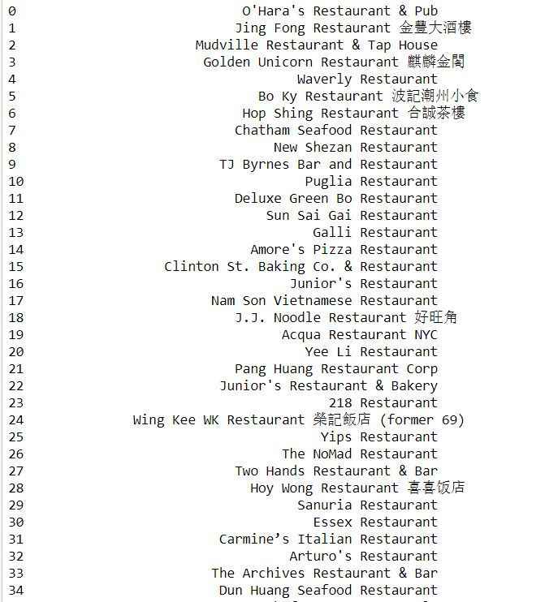
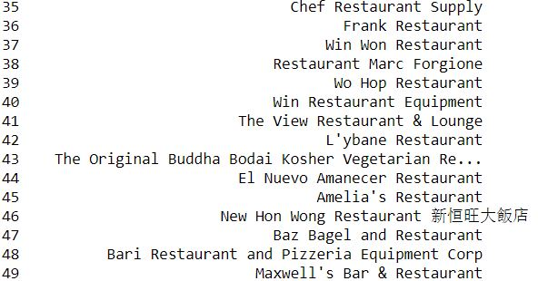
2. List of Restaurant’s
The next part was to retrieve the data about different restaurants in Manhattan with the help of Foursquare API.
For getting the data ,I used the search query with restaurant as the keyword.
The location of these restaurants were plotted in a map.

Slide 11
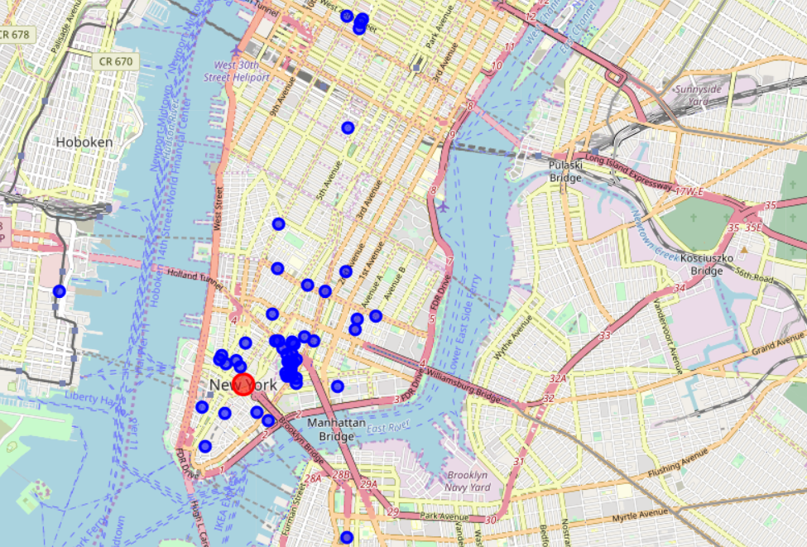
3. LIST OF RESTAURANTS PLOTTED IN A MAP

Slide 12
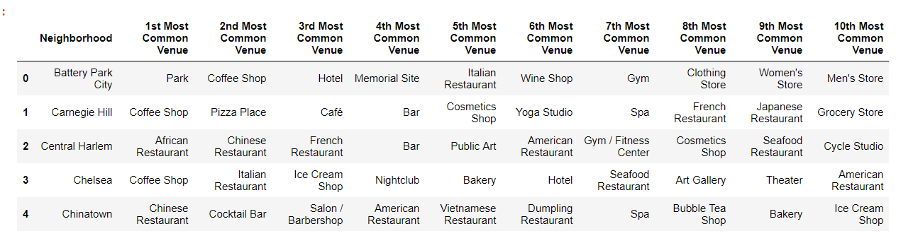
4. Neighbourhood along with the top 10 most common venues
Then using the Foursquare API the list of neighbourhood along with top 10 commonly visited places where obtained.

Slide 13
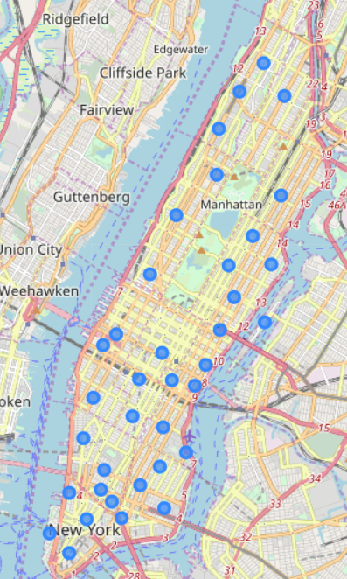
5. LIST OF NEIGHBOURHOOD
PLOTTED ON MAP

Slide 14
5.Clustering
The nearby venues obtained where clustered into five clusters using k-means.
The clusters obtained where analysed closely
Each location where evaluated depending on the parameters

Slide 15
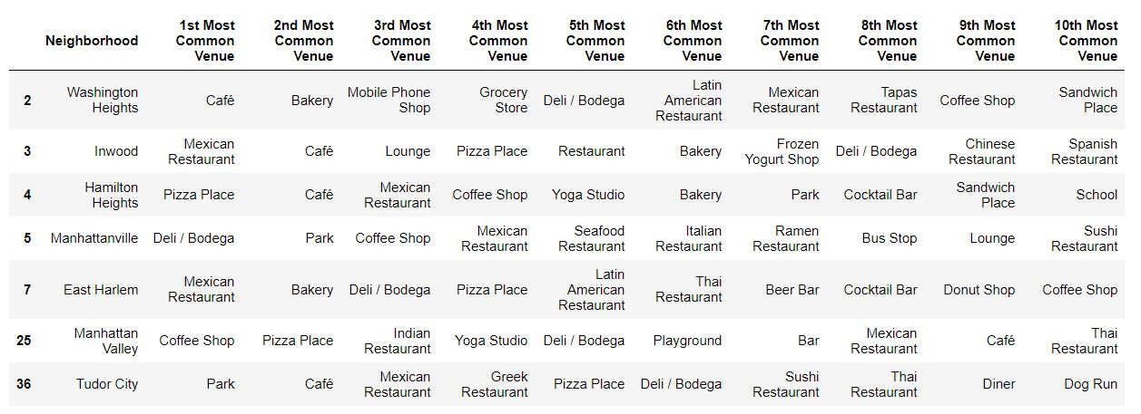
CLUSTER 1

Slide 16
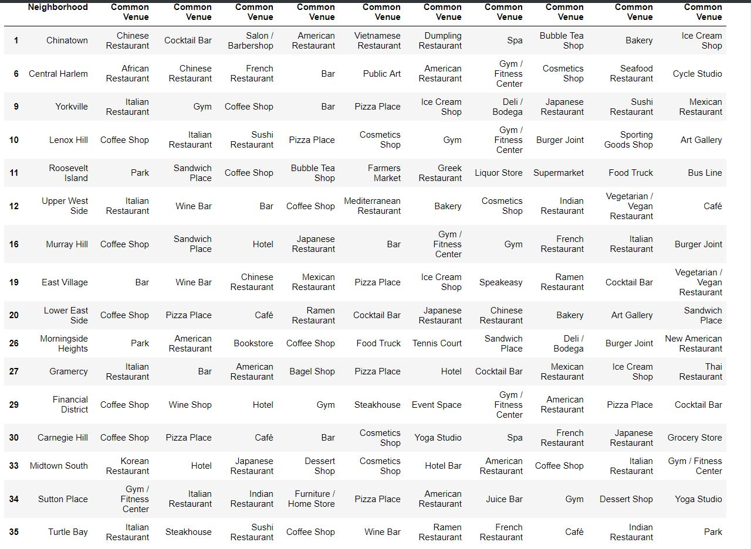
CLUSTER 2

Slide 17
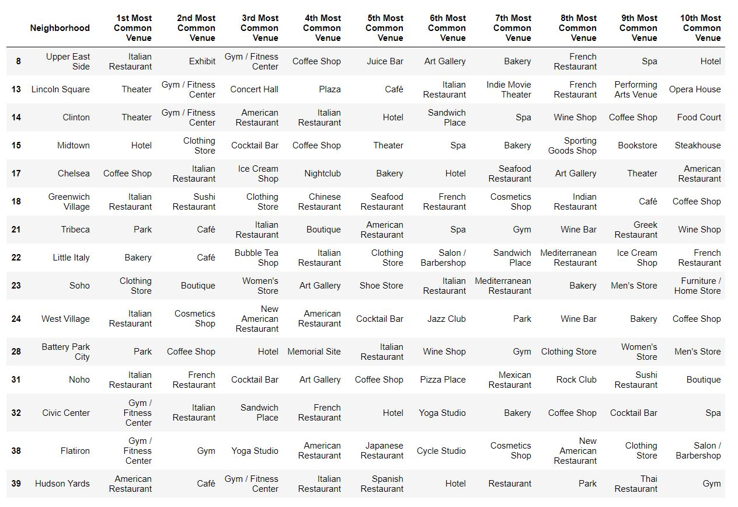
CLUSTER 3

Slide 18
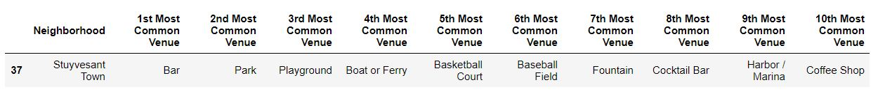
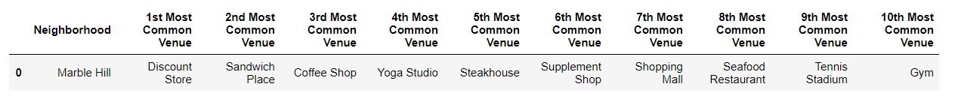
CLUSTER 4
CLUSTER 5

Slide 19
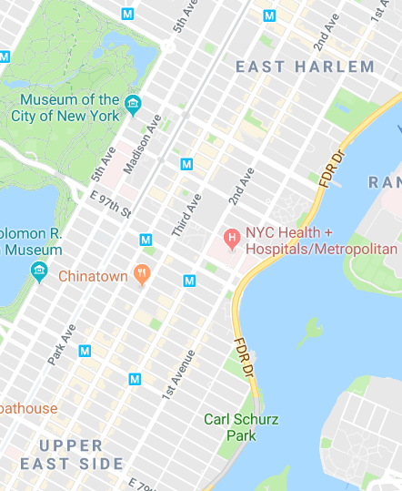
RESULT
After evaluating the clusters I have came to the conclusion that the suitable place for starting a new restaurant is between East Harlem and Upper East Side.
This is because they are near two museum which is visited by a number of people and a hospital.
Also East Harlem is a pilgrimage for foodies.

Slide 20
DISCUSSION
Eventhough I have considered the population ,
per capita income and population density of
five borough’s, I didn’t considered these parameters
in Manhattan alone. So the result can be improved
by considering these factors. Also with further evaluation of interest of people we could determine which type of restaurant is suitable.
I have done the analysis with limited number of data , so the competition caused by other restaurants and crime rates data can improve the location within the suggested location ie between East Harlem and Upper East Side

Slide 21
CONCLUSION
In this project, I have gone through the process of identifying the business problem, specifying the data required, extracting , preparing and cleaning the data , performing the machine learning by utilizing k-means clustering and providing recommendation to the entrepreneur.

